Slide 1
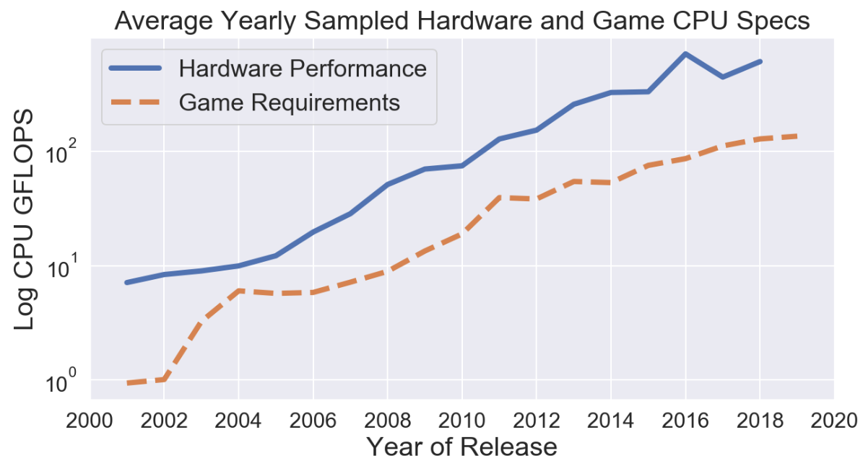

Slide 2
~4 years

Slide 3
~7 years
~4 years

